Slide 1
Git Branching/Merging +
GitLab CI/CD
By: John Meyer, John Hata, Noah Dunn, Jimmy Warren

Slide 2
Git Branching + Merging

Slide 3

History of VCS
The first documented case of Version Control System is SCCS (1972) which provided the foundation for branch and merge technology
Modern VCS like Git and SVN use the latest and greatest implementations of these technologies.
For our purposes we are going to discuss Git
http://blog.brew.com.hk/the-evolution-of-version-control-systems/
https://www.atlassian.com/git/tutorials/what-is-git

Slide 4
Background: How does Git work?
Git is a Version Control System (VCS)
Keeps track of different version of codebase
Git takes snapshots of codebase and stores them in “commits”
SHA1 id
Link to parent commit id
Links to files (by SHA1 hash)
Author name & email
Git saves references to commits using “branches”
Points to a single commit id
When a commit is added to a branch, the branch reference is updated

Slide 5
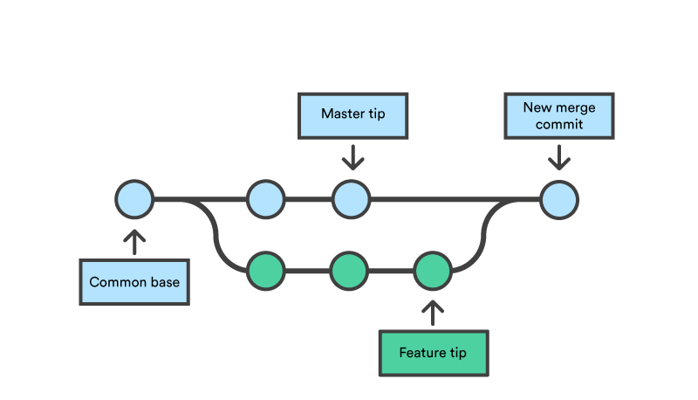
What is Branching?
Branching
Creates branches from the master branch to separate work
Changes to a side-branch do not change the content of the master branch
Merging
Joins branches back together
Updates the master branch with the changes of the side-branch
https://www.atlassian.com/git/tutorials/using-branches/git-merge

Slide 6

Philosophy of Branching
Branching and Merging are techniques used to implement what we call Version Control System.
The objective of any Version Control System is to keep all of our developers on the same, consistent code base.
We use branches and merges to avoid “Silo Programming”, in which programmers write large batches of code on their own, without any knowledge of what is going on outside of their specified areas
https://www.wrike.com/blog/break-down-work-silos/

Slide 7
Our Ultimate Goals
Organize code versions such that:
We can release the code using Semantic versioning
We can maintain multiple versions of the code at the same time

Slide 8
Semantic versioning
MAJOR.MINOR.PATCH
MAJOR: Counter for API-breaking changes
MINOR: Counter for backwards-compatible feature
PATCH: Counter for backwards-compatible bug fix
1.0.0 < 1.0.1 < 1.1.0 < 2.0.0 < 2.1.0
https://semver.org/

Slide 9
The Tradeoffs/Dangers of Branching/Merging
Three main dangers of branching and merging:
Stability
Relies on everyone understanding good Version Control practices. We want to avoid hundreds of redundant branches being created.
Merge conflicts
Multiple developers working on the same content can lead to a conflict, working on isolated branches helps to solve conflicts when merging.
Siloing
Dangerous in VCS as code merged from silos may not mesh with the current project.

Slide 10
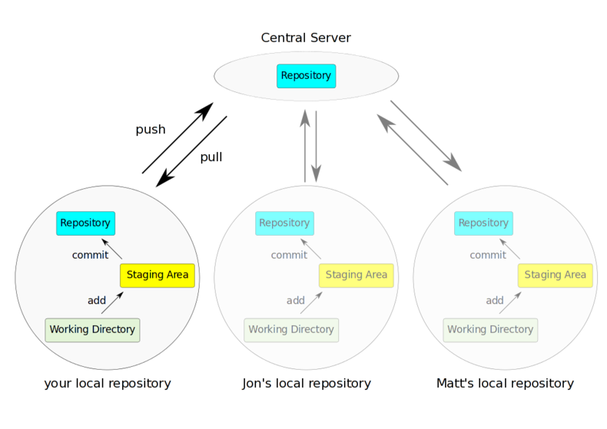
Workflow 1: Centralized repository
What you’ve been doing already
A centralized repository workflow is where multiple developers all push to a shared repository
E.g. Everyone commits to their local master branch and push to the remote’s master branch
https://aidanbudd.github.io/course_EMBO_at_TGAC_PPI_Sep2015/trainingMaterial/holgerDinkel/git/git_intro.html
https://www.atlassian.com/git/tutorials/comparing-workflows#centralized-workflow

Slide 11
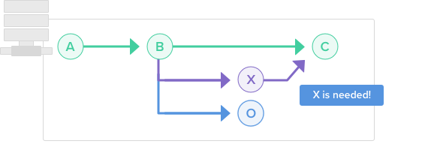
Workflow 2: Feature/Topic branches
We have a central repository, and master acts as our “Project History”
We branch every time we want to work on a new feature
Use very descriptive branch names
Merge into master as soon as we are willing to show off the feature
https://www.atlassian.com/git/tutorials/comparing-workflows/feature-branch-workflow
https://git-scm.com/book/en/v2/Git-Branching-Branching-Workflows
https://backlog.com/git-tutorial/branching-workflows/feature-branch-workflow

Slide 12
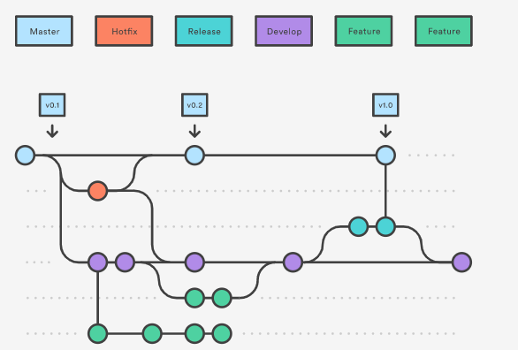
Workflow 3: Gitflow Workflow
Use two branches to record the history of a project: master and develop
Master: Stores the official release history, what we actually want to consider as “finished”
Develop: Where we store everything currently in development
Makes use of
feature branching (discussed before)
release branching (for updates to master)
hotfix branching (when we find a quick bugfix)
https://www.atlassian.com/git/tutorials/comparing-workflows/gitflow-workflow
https://git-scm.com/book/en/v2/Git-Branching-Branching-Workflows

Slide 13
Workflow 4: Forking workflow
Instead of using a single server-side repository to act as the central codebase(gitflow), it gives every developer their own server-side repository
Each developer must have two Git repositories(a local one and a server-side one)
Forking: creates a full copy of the main repository
This repository is stored on your GitHub account not using Git
Most often used for public open-source projects
https://www.atlassian.com/git/tutorials/comparing-workflows/forking-workflow

Slide 14
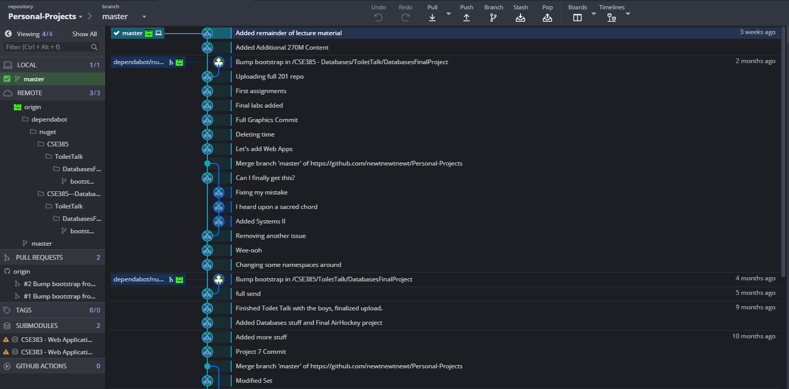
Sidebar: Visualizing Git workflow
GitKraken: https://www.gitkraken.com/download

Slide 15
Basic Git Branching + Merging
Create a Branch:
$ git checkout -b branch-name
Merging to master:
$ git checkout master $ git merge --no-ff branch-name
https://git-scm.com/book/en/v2/Git-Branching-Basic-Branching-and-Merging

Slide 16
Example merge
# Local repo
$ git init test-repo
$ cd test-repo/
$ echo "Original content - line 1" >> file
$ for _ in {1..10}; do echo "" >> file; done
$ echo "Original content - line 2" >> file
$ for _ in {1..10}; do echo "" >> file; done
$ echo "Original content - line 3" >> file
$ git add file
$ git commit -m "Add initial file"
$ git push

Slide 17
Example merge
Step 2: Working Copy B
Step 1: Working Copy A
# Local repo
$ git checkout master -b feature-a
$ echo "Original content - line 1" > file
$ for _ in {1..10}; do echo "" >> file; done
$ echo "Feature A content - line 2" >> file
$ for _ in {1..10}; do echo "" >> file; done
$ echo "Original content - line 3" >> file
$ git add file
$ git commit -m "Add feature A"
$ git push
# Local repo
$ git checkout master -b feature-b
$ echo "Original content - line 1" > file
$ for _ in {1..10}; do echo "" >> file; done
$ echo "Original content - line 2" >> file
$ for _ in {1..10}; do echo "" >> file; done
$ echo "Feature B content - line 3" >> file
$ git add file
$ git commit -m "Add feature B"
$ git push
$ git fetch
$ git checkout master
$ git merge --no-ff feature-a
$ git merge --no-ff feature-b
Step 3: Merge Into Working Copy C
Notes:
Indicate what working copy Indicate use of push since it is operating on local

Slide 18
Example merge conflict
$ git init test-repo
$ cd test-repo/
$ echo "Original content - line 1" >> file
$ for _ in {1..10}; do echo "" >> file; done
$ echo "Original content - line 2" >> file
$ for _ in {1..10}; do echo "" >> file; done
$ echo "Original content - line 3" >> file
$ git add file
$ git commit -m "Add initial file"

Slide 19
Example merge conflict
$ git checkout master -b feature-a
$ echo "Feature A content - line 1" > file
$ for _ in {1..10}; do echo "" >> file; done
$ echo "Feature A content - line 2" >> file
$ for _ in {1..10}; do echo "" >> file; done
$ echo "Original content - line 3" >> file
$ git add file
$ git commit -m "Add feature A"
$ git checkout master -b feature-b
$ echo "Original content - line 1" > file
$ for _ in {1..10}; do echo "" >> file; done
$ echo "Feature B content - line 2" >> file
$ for _ in {1..10}; do echo "" >> file; done
$ echo "Feature B content - line 3" >> file
$ git add file
$ git commit -m "Add feature B"
(Notice that line 2 is changed in both feature A and feature B)

Slide 20
Example merge conflict
$ git checkout master
$ git merge --no-ff feature-a
$ git merge --no-ff feature-b
Auto-merging file
CONFLICT (content): Merge conflict in file
Automatic merge failed; fix conflicts and then commit the result.
$ git status
On branch master
You have unmerged paths.
(fix conflicts and run "git commit") <-- "I’ve fixed the conflicts. Let’s do this"
(use "git merge --abort" to abort the merge) <-- "I give up. Pretend I didn’t even do this"
Unmerged paths:
(use "git add <file>..." to mark resolution)
both modified: file
no changes added to commit (use "git add" and/or "git commit -a")

Slide 21
Example merge conflict
Feature A content - line 1
<<<<<<< HEAD
Feature A content - line 2
=======
Feature B content - line 2
>>>>>>> feature-b
Feature B content - line 3
Feature A content - line 1
Feature A & B content - line 2
Feature B content - line 3
Edit
Notes:
Add a result in here with an arrow on the right.

Slide 22
Merge Conflicts
Merge conflicts are an inevitability, it is important to understand how to deal with them.
Use git status to determine files listed as “unmerged”
Open files in editor, which are now marked with <<<<<, =====, >>>>> to indicate differences between the two files
Incorporate the intended change of each branch into one version & remove merge annotations
Ensure no other merge annotation exist
Finish merge by running git commit
If configured, git mergetool offers a visual prompt for merge resolution
https://git-scm.com/book/en/v2/Git-Branching-Basic-Branching-and-Merging

Slide 23
GitLab CI/CD
https://youtu.be/EuwLdbCu3DE
https://docs.gitlab.com/ee/ci/introduction/

Slide 24
What is CI/CD?
Continuous Integration (CI)
The practice of merging all developers' working copies to a shared mainline several times a day --Wikipedia
Continuous deployment (CD)
The ability to get changes of all types—including new features, configuration changes, bug fixes and experiments—into production, or into the hands of users, safely and quickly in a sustainable way. --continuousdelivery.com

Slide 25
What are the goals of CI/CD?
Continuous Integration (CI)
Merging with confidence that product won’t break unexpectedly
Continuous deployment (CD)
Deploying consistently without unnecessary friction

Slide 26
How to achieve CI/CD without extra overhead?
Automation!
Many tools exist:
GitLab CI
GitHub Actions
Circle CI
Jenkins
etc.
We will focus on GitLab CI

Slide 27
What can GitLab CI do to assist CI/CD?
Execute commands over code
Compile
Test/code coverage
Package
Publish to app store
Display results in GitLab UI
Visual display for success/failure
Links to staging deployments

Slide 28
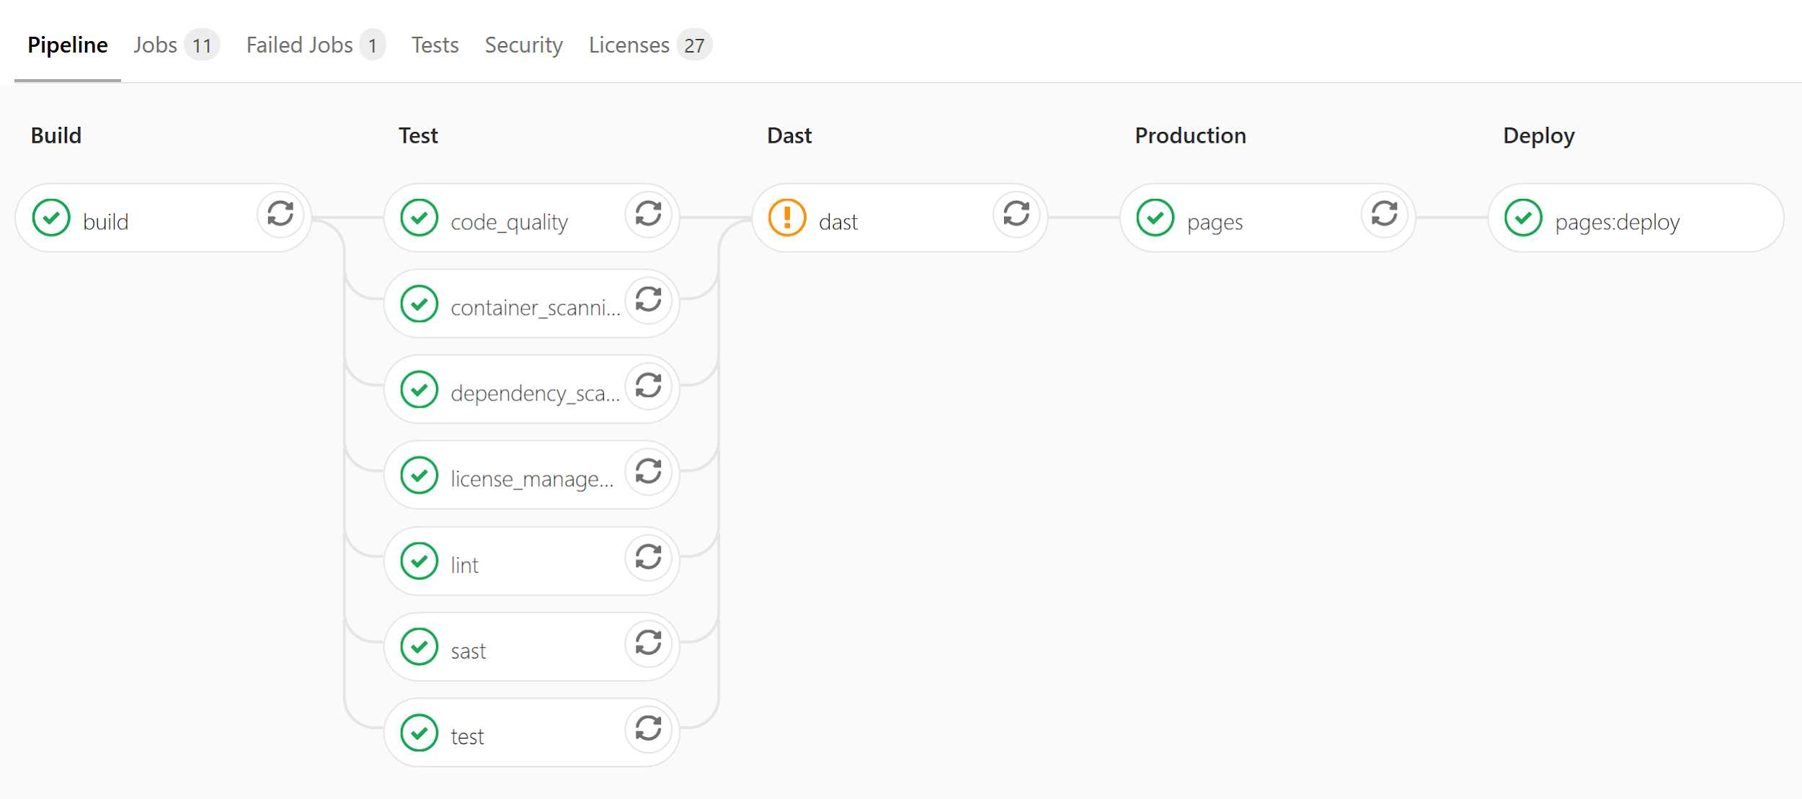
Example visual display

Slide 29
How to configure: .gitlab-ci.yml
Configuration file used by GitLab CI implementation
If it is present, we use it like a normal configuration file
If it is not present, CI functionality is ignored.
As indicated by the extension, .yml, it is in YAML format

Slide 30
How to configure: .gitlab-ci.yml
image: alpine:latest
stages:
- build
- test
- deploy
build:
stage: build
image: node:lts
before_script:
- yarn install
script:
- cd packages/web/
- yarn build
artifacts:
paths:
- packages/web/build
lint:
stage: test
image: node:lts
before_script:
- yarn install
script: yarn lint

Slide 31
How to configure: .gitlab-ci.yml
pages:
stage: deploy
only:
- master
dependencies:
- build
script:
- mv packages/web/build/ public/
artifacts:
paths:
- public
build:
# ...
artifacts:
paths:
- packages/web/build

Slide 32
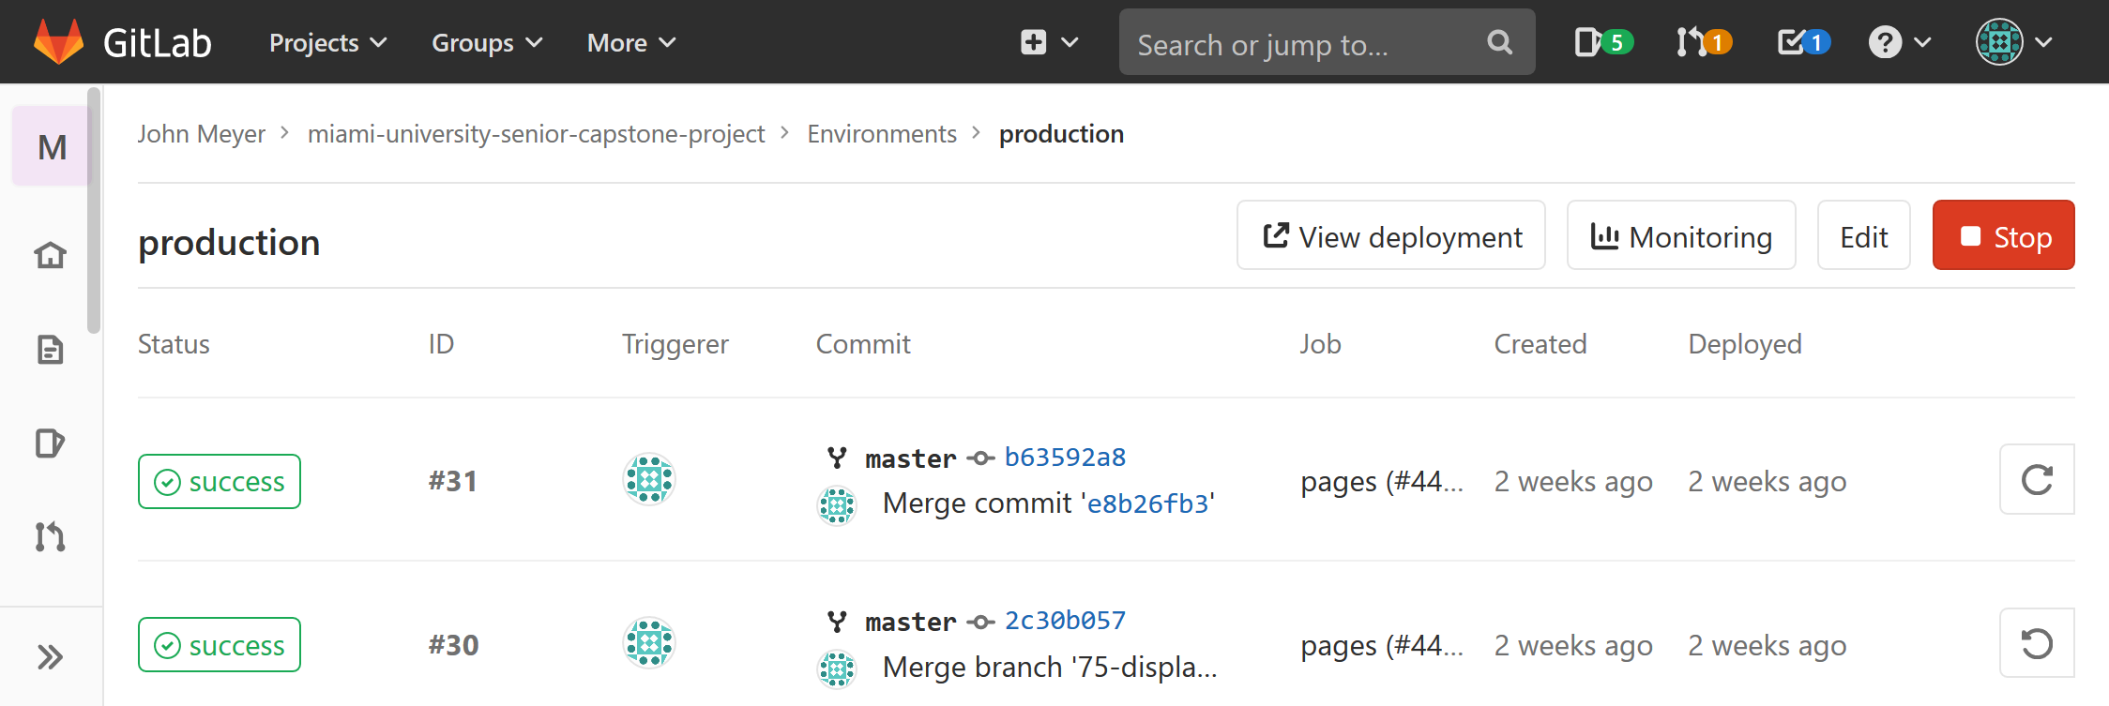
How to configure: .gitlab-ci.yml
pages:
# ...
environment:
name: production
url: $CI_PAGES_URL
cache:
key:
files:
- yarn.lock
paths:
- node_modules/
- .yarn

Slide 33
How GitLab CI works
Jobs are executed by GitLab Runners
GitLab Runners are daemon programs that wait for CI jobs, execute them, and post the results
Daemon: Continually-running program

Slide 34
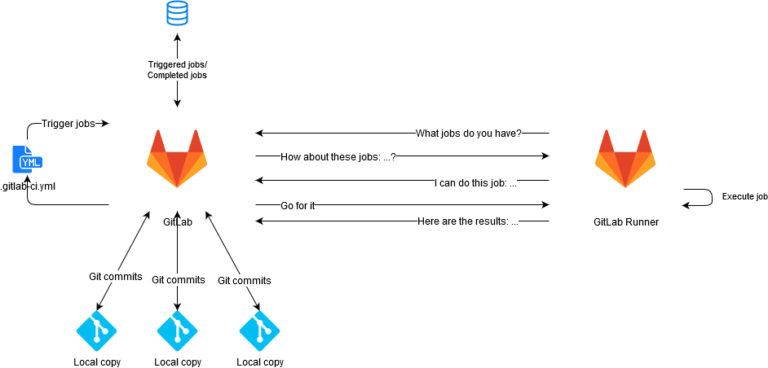
How GitLab CI works

Slide 35
How GitLab CI works
They are typically installed on a separate server from the GitLab UI
If there are no registered Runners then all jobs will fail
GitLab admin will typically provide all users with “Shared” GitLab Runners
You can also register privately-installed Runners with individual repos or groups

Slide 36
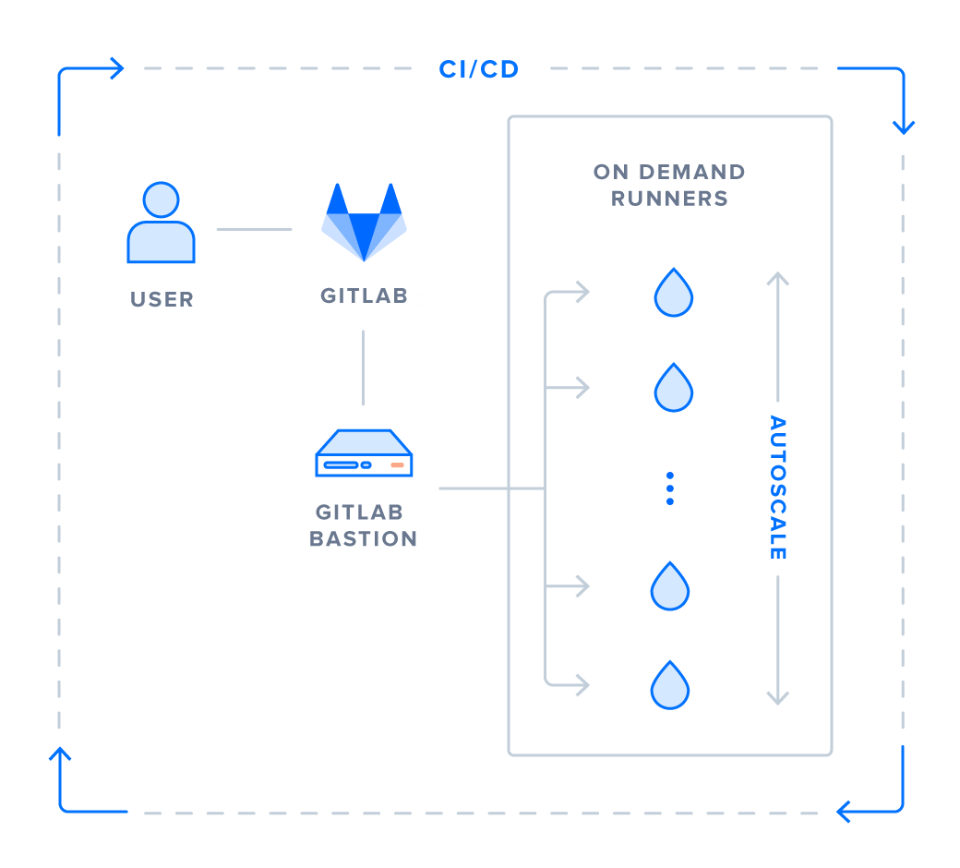
Understanding a GitLab Runner
Runners are daemons (continually-running programs) that seek requested CI/CD jobs and complete them.
They need to be installed on a server to actually perform work
https://about.gitlab.com/blog/2018/06/19/autoscale-continuous-deployment-gitlab-runner-digital-ocean/

Slide 37
Complete CI Yaml Script
https://gitlab.csi.miamioh.edu/meyerjm/cse451-meyerjm-ci-demo/blob/master/.gitlab-ci.yml

Slide 38
Variables
variables:
PRODUCTION_HOST: example.com
PRODUCTION_HOST_SSH_USER: user
PRODUCTION_HOST_DOCUMENT_ROOT: /var/www/html
PROXY_HOST: ceclnx01.cec.miamioh.edu
PROXY_SSH_USER: uniqueid
YAML enables us to declare variables as key-value pairs. Variables or values denoted with a $VALUE or ${VALUE} are environmental variables that can be set in the GitLab CI/CD

Slide 39
Docker Image Selection
image: alpine
Jobs are executed in Docker containers. This specifies which Docker image it should use for jobs.

Slide 40
before_script
before_script:
- apk update
##
## Install ssh-agent if not already installed, it is required by Docker.
## (change apt-get to yum if you use an RPM-based image)
##
- which ssh-agent || (apk add --no-cache openssh-client)
##
## Run ssh-agent (inside the build environment)
##
- eval $(ssh-agent -s)
This executes before the remainder of the job. It configures SSH on our runner so we can execute commands on other servers using SSH

Slide 41
##
## Add the SSH key stored in SSH_PRIVATE_KEY variable to the agent store
## We're using tr to fix line endings which makes ed25519 keys work
## without extra base64 encoding.
## https://gitlab.com/gitlab-examples/ssh-private-key/issues/1#note_48526556
##
- echo "${PROXY_SSH_PRIVATE_KEY}" | tr -d '\r' | ssh-add -
- unset SSH_PRIVATE_KEY
- echo "${PRODUCTION_HOST_SSH_PRIVATE_KEY}" | tr -d '\r' | ssh-add -
- unset SSH_PRIVATE_KEY
##
## Create the SSH directory and give it the right permissions
##
- mkdir -p ~/.ssh
- chmod u=rwx,go= ~/.ssh

Slide 42
stages:
- deploy
- test
deploy-production:
stage: deploy
environment:
name: production
url: http://${PRODUCTION_HOST}/${CI_PROJECT_NAME}
on_stop: stop-deploy-production
only:
- master
script:
- rsync -hr --progress --delete --exclude branch/ --exclude .git/
.
production:${PRODUCTION_HOST_DOCUMENT_ROOT}/${CI_PROJECT_NAME}
This portion defines the various stages, set to be whatever we desire. From there, we can write tasks like deploy-production and deploy-development, which activate at their specified stages, and run the scripts specified

Slide 43
Additional Stage Task
lint:
stage: test
script:
- tidy -iqm -ashtml -access -utf8 *.html
- git diff --quiet
For Additional Information On YAML configuration setup, Read Here: https://docs.gitlab.com/ee/ci/yaml/

Slide 44
Appendix: Installing GitLab Runner in a hardened environment

Slide 45
Creating a non-privileged user
$ sudo adduser gitlab-runner --shell /bin/bash --disabled-login
$ sudo su - gitlab-runner

Slide 46
WIP: Setting up Systemd user daemon
$ sudo mkdir -p /run/user/$(id -u gitlab-runner)
$ sudo chown gitlab-runner:gitlab-runner /run/user/$(id -u gitlab-runner)
$ echo 'export XDG_RUNTIME_DIR=/run/user/$(id -u)' >> ~gitlab-runner/.bashrc

Slide 47
Installing Docker daemon in rootless mode
# See also <https://www.katacoda.com/courses/docker/rootless>
# See <https://youtu.be/Qq78zfXUq18> and <https://youtu.be/tEH-Kk5EMZ0>
# See <https://docs.docker.com/engine/security/rootless/>
$ curl -fsSL https://get.docker.com/rootless | sh
# Set environment variables according to instructions in script output
$ systemctl --user start docker
$ sudo loginctl enable-linger $(whoami)

Slide 48
Installing Docker Compose
# Choosing not to install via `apt` or `snap` since this will also install root Docker daemon
$ sudo apt update
$ sudo apt install python python-dev python-pip python3 python3-dev python3-pip build-essential
$ pip3 install --user pipenv
$ pipenv --python 2
$ pipenv install docker-compose
$ pipenv shell
# Make sure to run all `docker-compose` commands in this pipenv shell

Slide 49
Set up docker-compose.yml
version: '3'
services:
gitlab-runner:
image: gitlab/gitlab-runner
restart: always
volumes:
- $XDG_CONFIG_HOME/gitlab-runner:/etc/gitlab-runner
- $XDG_RUNTIME_DIR/docker.sock:/var/run/docker.sock
gitlab-runner-docker-cleanup:
image: quay.io/gitlab/gitlab-runner-docker-cleanup
restart: always
volumes:
- $XDG_RUNTIME_DIR/docker.sock:/var/run/docker.sock
environment:
LOW_FREE_SPACE: '10G'
EXPECTED_FREE_SPACE: '20G'
LOW_FREE_FILES_COUNT: '1048576'
EXPECTED_FREE_FILES_COUNT: '2097152'
DEFAULT_TTL: '10m'
USE_DF: '1'

Slide 50
Set up docker-compose.yml
$ export $XDG_CONFIG_HOME=~/.config
$ mkdir -p $XDG_CONFIG_HOME/gitlab-runner

Slide 51
Register GitLab Runner to a GitLab instance
$ docker run --rm -it \
-v $XDG_CONFIG_HOME/gitlab-runner:/etc/gitlab-runner \
gitlab/gitlab-runner \
register
Answer the prompts:
Set at least the following tags:
linux
docker
System architecture (e.g. uname -m)
Choose the docker executor
Go to the GitLab UI and check "Run untagged jobs"

Slide 52
Installing self-signed TLS certificates, if needed
Add all trusted root certificates to $XDG_CONFIG_HOME/gitlab-runner/certs/ca.cert

Slide 53
GitLab Runner Usage
Running:
$ docker-compose up -d
Restarting:
$ docker-compose restart
Upgrading:
$ docker-compose pull
$ docker-compose down && docker-composer up
Viewing logs:
$ docker-compose logs

